Slide 1
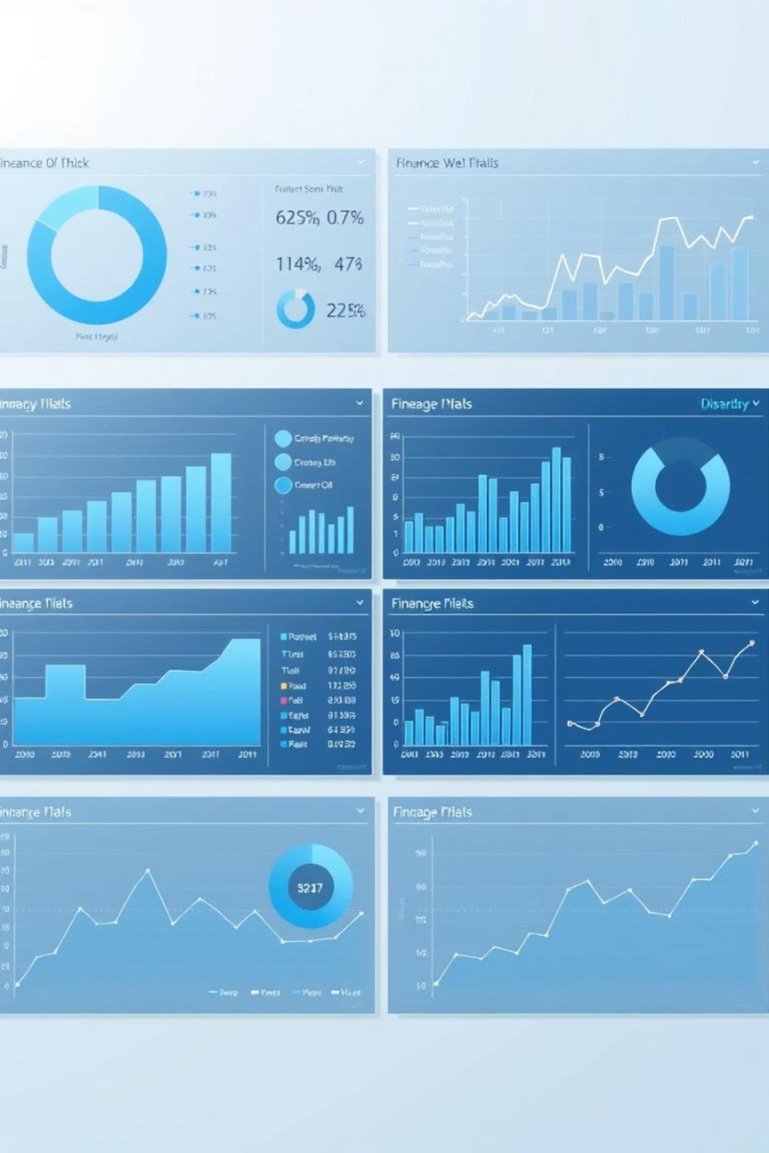
Unlocking Business Insights with Power BI Dashboards
In today's data-driven landscape, transforming raw data into actionable insights is crucial for strategic decision-making. This presentation outlines our approach to designing and developing an interactive Power BI dashboard tailored for business stakeholders, empowering them to explore key performance indicators and uncover hidden opportunities.
Notes:
1

Slide 2
Agenda
Dashboard Design: A Strategic Approach
01
02
03
Understanding the Objective
Key Design Principles
Tools and Deliverables
Defining the core purpose and target audience for the dashboard.
Exploring the foundational elements for an effective dashboard.
Outlining the technology and outputs of the project.
04
05
Interactive Features
Visual Cohesion & Navigation
Highlighting functionalities that enhance user engagement.
Ensuring a consistent and intuitive user experience.
Notes:
2

Slide 3



Objective: Empowering Business Stakeholders
Our primary objective is to design an interactive Power BI dashboard that serves as a central hub for critical business insights. This dashboard will enable stakeholders to monitor performance, identify trends, and make informed decisions quickly and efficiently.
Data-Driven Decisions
Targeted Audience
Actionable Insights
Facilitating quick access to vital metrics for strategic planning.
Specifically designed for business stakeholders with varying levels of technical expertise.
Transforming raw data into clear, actionable intelligence to drive growth.
Notes:
3

Slide 4

Selecting the Right KPIs
Choosing the right Key Performance Indicators (KPIs) is fundamental to any effective dashboard. For business stakeholders, we focus on metrics that directly impact financial health and operational efficiency.
Sales Performance: Total revenue, sales growth, average transaction value.
Profitability: Gross profit margin, net profit, cost of goods sold.
Growth Metrics: Customer acquisition rate, market share, revenue per employee.
Operational Efficiency: Inventory turnover, customer service response time.
These KPIs provide a holistic view of the business, allowing stakeholders to quickly gauge performance and pinpoint areas for improvement.
Notes:
4

Slide 5
Enhancing Interactivity with Slicers and Filters
Interactivity is key to empowering users to explore data at their own pace and according to their specific needs. Slicers and filters in Power BI provide this crucial functionality.
Dynamic Data Exploration
Personalized Views
Efficiency in Analysis
Users can slice data by time, region, product category, or customer segment.
Enables stakeholders to customize their data view for deeper, more relevant analysis.
Reduces the need for multiple static reports by providing on-demand data manipulation.
This feature transforms the dashboard from a static report into a dynamic analytical tool.
Notes:
5

Slide 6

Time-Series Analysis and Trend Identification
Understanding trends over time is crucial for forecasting and strategic planning. Our dashboard will incorporate robust time-series analysis to visualize performance evolution.
By plotting key metrics against time, stakeholders can:
Identify Seasonal Patterns: Recognize recurring peaks and troughs in sales or customer activity.
Track Growth Trajectories: Observe long-term upward or downward trends in profitability or market share.
Assess Impact of Initiatives: Correlate specific business decisions with their effects on performance over time.
Notes:
6

Slide 7
Summary Cards for Instant Overview
For quick consumption and at-a-glance insights, the dashboard will feature prominent summary cards displaying aggregated totals for key metrics.
Total Sales
Overall Profit
Growth Rate
An immediate view of overall revenue generated within the selected period.
Clear display of net profitability, essential for financial health assessment.
Percentage change indicating business expansion or contraction over time.
These cards act as a high-level summary, allowing users to rapidly grasp the current state of the business before delving into detailed analysis.
Notes:
7

Slide 8
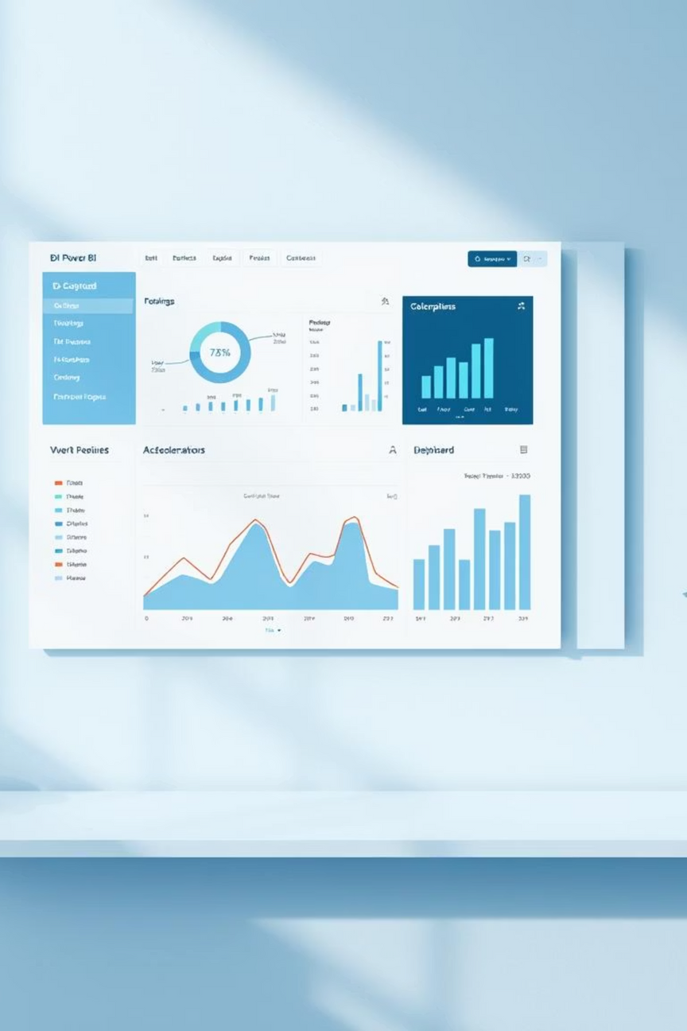

Consistent Visual Design: Theme and Color Palette
A consistent color theme is vital for a professional and user-friendly dashboard. It enhances readability, reinforces branding, and prevents data misinterpretation due to visual clutter.
Enhanced Readability: Thoughtfully chosen colors make data points and visuals easy to differentiate.
Brand Cohesion: Aligning the dashboard's aesthetics with the company's brand guidelines fosters familiarity and trust.
Reduced Cognitive Load: A harmonious color scheme allows users to focus on the insights rather than deciphering complex visuals.
We will apply a carefully selected color palette throughout all visual elements, including charts, tables, and summary cards.
Notes:
8

Slide 9





Intuitive Navigation Menu
For dashboards with multiple pages or detailed sections, an intuitive navigation menu is indispensable. It ensures users can effortlessly move between different views and find the information they need.
Design Buttons
Link Actions
Plan Pages
Test Flow
Implementing a clear navigation structure, whether through tabs, buttons, or bookmarks, significantly improves the user experience and overall usability of the dashboard.
Notes:
9

Slide 10



Key Takeaways & Next Steps
Strategic Insights
Enhanced Interactivity
Cohesive Design
The Power BI dashboard will deliver crucial insights into sales, profit, and growth.
Slicers and filters will enable dynamic and personalized data exploration.
A consistent visual theme and intuitive navigation will ensure a seamless user experience.
Next Steps: We will present a detailed wireframe of the dashboard layout, followed by a development timeline and regular progress updates.
Notes:
10

